Slide 1
Chapter 5：STATIC GAMES OF COMPLETE INFORMATION: Nash Equilibrium

Slide 2
We have seen three solution concepts that offer some insights into predicting the behavior of rational players in strategic (normal-form) games.
The first, strict dominance, relied only on rationality, and in some cases，it predicted a unique outcome. However, it often fails to exist.
Two sister concepts of IESDS and rationalizability relied on more than rationality by requiring common knowledge of rationality. A solution existed for every game, and for some games there was a unique prediction. Moreover, whenever there is a strict dominant equilibrium, it uniquely survives IESDS and rationalizability.
博弈论与信息经济学
北京航空航天大学经济管理学院 崔志伟

Slide 3
However, when we consider a game like the Battle of the Sexes, none of these concepts had any bite.
Dominant strategy equilibrium did not apply, and both IESDS and rationalizability could not restrict the set of reasonable behavior.
Chris
O
F
O
2, 1 | 0, 0
0, 0 | 1, 2
Alex
F
博弈论与信息经济学
北京航空航天大学经济管理学院 崔志伟

Slide 4

Chris
O
F
O
2, 1 | 0, 0
0, 0 | 1, 2
Alex
F
For example, we cannot rule out the possibility that Alex goes to the opera while Chris goes to the football game, because Alex may behave optimally given his belief that Chris is going to the opera, and Chris may behave optimally given his belief that Alex is going to the football game.
If we think of this pair of actions not only as actions, but as a system of actions and beliefs, then there is something of a dissonance: indeed the players are playing best responses to their beliefs, but their beliefs are wrong!
博弈论与信息经济学
北京航空航天大学经济管理学院 崔志伟

Slide 5
In this chapter we make a rather heroic leap that ties together beliefs and actions and results in the most central and best-known solution concept in game theory.
For dominant strategy equilibrium we required only that players be rational, while for IESDS and rationalizability we required common knowledge of rationality.
Now we introduce a much more demanding concept, that of the Nash equilibrium, first put forth by John Nash (1950a).
博弈论与信息经济学
北京航空航天大学经济管理学院 崔志伟

Slide 6


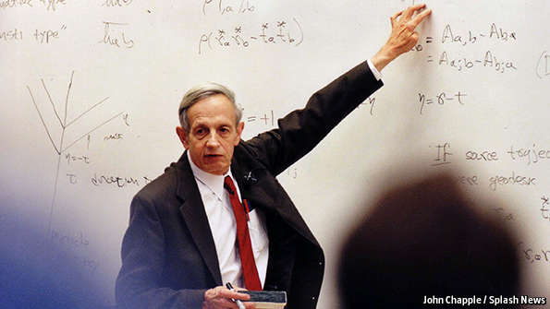
博弈论与信息经济学
北京航空航天大学经济管理学院 崔志伟

Slide 7
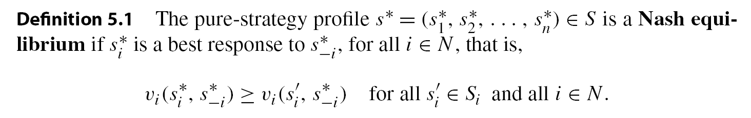
5.1 Nash Equilibrium in Pure Strategies
A Nash equilibrium is a system of beliefs and a profile of actions for which each player is playing a best response to his beliefs and, moreover, players have correct beliefs.
Another common way of defining a Nash equilibrium, which does not refer to beliefs, is as a profile of strategies for which each player is choosing a best response to the strategies of all other players.
博弈论与信息经济学
北京航空航天大学经济管理学院 崔志伟

Slide 8
Player 2
L
C
R
U
4, 3 | 5, 1 | 6, 2
2, 1 | 8, 4 | 3, 6
3, 0 | 9, 6 | 2, 8
Player 1
M
D
In this game, the only pair of pure strategies that survived IESDS is the pair (U, L). This is also the only pair of strategies that constitutes a Nash equilibrium.
If player 2 is playing the column L, then player 1’s best response is BR₁(L) = {U}; at the same time, if player 1 is playing the row U, then player 2’s best response is BR₂(U) = {L}.
博弈论与信息经济学
北京航空航天大学经济管理学院 崔志伟

Slide 9
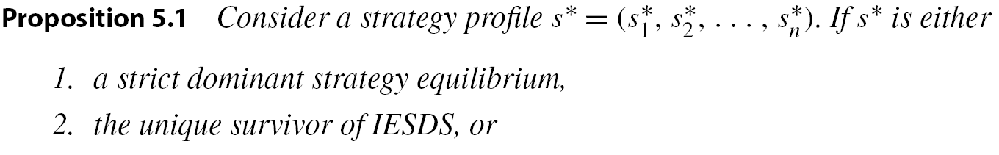
Player 2
Consider the Prisoner’s Dilemma.
M
F
M
-2, -2 | -5, -1
-1, -5 | -4, -4
Player 1
F
There is a simple relationship between the concepts we previously explored and that of Nash equilibrium, as the following proposition clearly states:
博弈论与信息经济学
北京航空航天大学经济管理学院 崔志伟

Slide 10
Let me emphasize the requirements for a Nash equilibrium:
1. Each player is playing a best response to his beliefs.
2. The beliefs of the players about their opponents are correct.
The first requirement is a direct consequence of rationality. It is the second requirement that is very demanding.
It is one thing to ask people to behave rationally given their beliefs (play a best response), but it is a totally different thing to ask players to predict the behavior of their opponents correctly.
博弈论与信息经济学
北京航空航天大学经济管理学院 崔志伟

Slide 11
Consider the Battle of the Sexes game.
Chris
O
F
O
2, 1 | 0, 0
0, 0 | 1, 2
Alex
F
博弈论与信息经济学
北京航空航天大学经济管理学院 崔志伟

Slide 12

博弈论与信息经济学
北京航空航天大学经济管理学院 崔志伟

Slide 13
There is a game called Chicken, in which two people drive two very fast cars towards each other from opposite ends of a long straight road. If one of them swerves before the other, he is called a chicken. Of course, if neither swerves, they will crash. The worst possible payoff is to crash into each other, so we assign this a value 0. The best payoff is to have your opponent be the chicken, so we assign this a value 3. The next to worst possibility is to be the chicken, so we assign this a value 1. The last possibility is that both drivers swerve. Then, neither has less honor than the other, so this is preferable to being the chicken. However, it is not quite as good as being the victor, so we assign it a value 2.
S
NS
S
2, 2 | 1, 3
3, 1 | 0, 0
NS
博弈论与信息经济学
北京航空航天大学经济管理学院 崔志伟

Slide 14
5.1.1 Pure-Strategy Nash Equilibrium in a Matrix
Consider the following two-person finite game in matrix form:
Player 2
L
C
H
U
7, 7 | 4, 2 | 1, 8
2, 4 | 5, 5 | 2, 3
8, 1 | 3, 2 | 0, 0
Player 1
M
D
No strategy is dominated and thus that strict dominance cannot be applied to this game. For the same reason, IESDS will conclude that anything can happen.
Rationalizability？
博弈论与信息经济学
北京航空航天大学经济管理学院 崔志伟

Slide 15
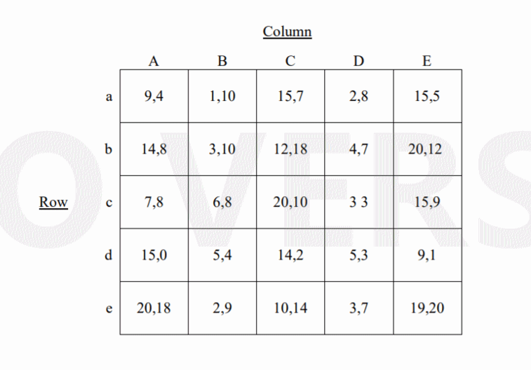
博弈论与信息经济学
北京航空航天大学经济管理学院 崔志伟

Slide 16
To find a pure-strategy Nash equilibrium we use a simple method that builds on the fact that any Nash equilibrium must call for a pair of strategies in which each of the two players is playing a best response to his opponent’s strategy. The procedure is best explained in three steps:
Step 1: For every column, which is a strategy of player 2, find the highest payoff entry for player 1. Underline the pair of payoffs in this row under this column.
Step 1 identifies the best response of player 1 for each of the pure strategies (columns) of player 2.
博弈论与信息经济学
北京航空航天大学经济管理学院 崔志伟

Slide 17
Step 2: For every row, which is a strategy of player 1, find the highest payoff entry for player 2. Overline the pair of payoffs in this entry.
Step 2 identifies the pairs of strategies at which player 2 is playing a best response.
Step 3: If any matrix entry has both an under- and an overline, it is the outcome of a Nash equilibrium in pure strategies.
This follows from the fact that both players are playing a best response at any such pair of strategies.
博弈论与信息经济学
北京航空航天大学经济管理学院 崔志伟

Slide 18
Chris
O
F
O
2, 1 | 0, 0
0, 0 | 1, 2
Alex
F
博弈论与信息经济学
北京航空航天大学经济管理学院 崔志伟

Slide 19
Player 2
L
C
H
U
4, 3 | 5, 1 | 6, 2
2, 1 | 8, 4 | 3, 6
3, 0 | 9, 6 | 2, 8
Player 1
M
D
博弈论与信息经济学
北京航空航天大学经济管理学院 崔志伟

Slide 20
Player 2
L
C
H
U
7, 7 | 4, 2 | 1, 8
2, 4 | 5, 5 | 2, 3
8, 1 | 3, 2 | 0, 0
Player 1
M
D
博弈论与信息经济学
北京航空航天大学经济管理学院 崔志伟

Slide 21
博弈论与信息经济学
北京航空航天大学经济管理学院 崔志伟

Slide 22
5.1.2 Evaluating the Nash Equilibria Solution
Considering our criteria for evaluating solution concepts, we can see from the Battle of the Sexes example that we may not have a unique Nash equilibrium. There is no reason to expect that we should.
As with the previous solution concepts, we can easily see that Nash equilibrium does not guarantee Pareto optimality. Left to their own devices, people in many situations will do what is best for them, at the expense of social efficiency.
博弈论与信息经济学
北京航空航天大学经济管理学院 崔志伟

Slide 23
Consider the following Rock-Paper-Scissors game:
Player 2
R
P
S
R
0, 0 | -1, 1 | 1, -1
1, -1 | 0, 0 | -1, 1
-1, 1 | 1, -1 | 0, 0
Player 1
P
S
For the interested reader, Section 6.4 discusses some conditions that guarantee the existence of a Nash equilibrium, which was a central part of Nash’s Ph.D. dissertation. This fact gives the Nash solution concept its power—like IESDS and rationalizability, the solution concept of Nash is widely applicable.
博弈论与信息经济学
北京航空航天大学经济管理学院 崔志伟

Slide 24
5.2 Nash Equilibrium: Some Classic Applications
The Nash equilibrium solution concept has been applied widely in economics, political science, legal studies, and even biology. In what follows we demonstrate some of the best-known applications of the concept.
博弈论与信息经济学
北京航空航天大学经济管理学院 崔志伟

Slide 25
5.2.1 Two Kinds of Societies
The French philosopher Jean-Jacques Rousseau presented the following situation that describes a trade-off between playing it safe and relying on others to achieve a larger gain.
Two hunters, players 1and 2, can each choose to hunt a stag (S), which provides a rather large and tasty meal, or hunt a hare (H)—also tasty, but much less filling.
Hunting stags is challenging and requires mutual cooperation. If either hunts a stag alone, the chance of success is negligible, while hunting hares is an individualistic enterprise that is not done in pairs. Hence hunting stags is most beneficial for society but requires “trust” between the hunters in that each believes that the other is joining forces with him.
博弈论与信息经济学
北京航空航天大学经济管理学院 崔志伟

Slide 26
The game, often referred to as the Stag Hunt game, can be described by the following matrix:
S
H
S
5, 5 | 0, 3
3, 0 | 3, 3
H
The game has two Nash equilibria: (S, S) and (H, H). However, the payoff from (S, S) Pareto dominates that from (H, H).
If each player anticipates that the other will not join forces, then he knows that going out to hunt the stag alone is not likely to be a successful enterprise. This belief would result in a society of individualists who do not cooperate to achieve a better outcome.
博弈论与信息经济学
北京航空航天大学经济管理学院 崔志伟

Slide 27
S
H
S
5, 5 | 0, 3
3, 0 | 3, 3
H
The game has two Nash equilibria: (S, S) and (H, H). However, the payoff from (S, S) Pareto dominates that from (H, H).
In contrast, if the players expect each other to be cooperative in going after the stag, then this anticipation is self-fulfilling and results in what can be considered a cooperative society.
In the real world, societies that may look very similar in their endowments, access to technology, and physical environments have very different achievements, all because of self-fulfilling beliefs or, as they are often called, norms of behavior.
博弈论与信息经济学
北京航空航天大学经济管理学院 崔志伟

Slide 28
S
H
S
5, 5 | 0, 3
3, 0 | 3, 3
H
The game has two Nash equilibria: (S, S) and (H, H). However, the payoff from (S, S) Pareto dominates that from (H, H).
Coordination game: Pareto efficiency + Risk dominance.
博弈论与信息经济学
北京航空航天大学经济管理学院 崔志伟

Slide 29
5.2.2 The Tragedy of the Commons
The tragedy of the commons refers to the conflict over scarce resources that results from the tension between individual selfish interests and the common good; the concept was popularized by Hardin (1968).
The central idea has proven useful for understanding how we have come to be on the brink of several environmental catastrophes.
博弈论与信息经济学
北京航空航天大学经济管理学院 崔志伟

Slide 30

In the course of his essay, Hardin develops the theme, drawing on examples of such latter-day commons as the atmosphere, oceans, rivers, fish stocks, national parks, advertising, and even parking meters.
博弈论与信息经济学
北京航空航天大学经济管理学院 崔志伟

Slide 31
Hardin introduces the hypothetical example of a pasture shared by local herders.
Each herder wants to maximize his yield, increasing his herd size whenever possible. Each additional animal has a positive effect for its herder, but the cost of that extra animal, namely degradation of the overall quality of the pasture, is shared by all the other herders.
As a consequence the individual incentive for each herder is to grow his own herd, and in the end this scenario causes tremendous losses for everyone.
博弈论与信息经济学
北京航空航天大学经济管理学院 崔志伟

Slide 32
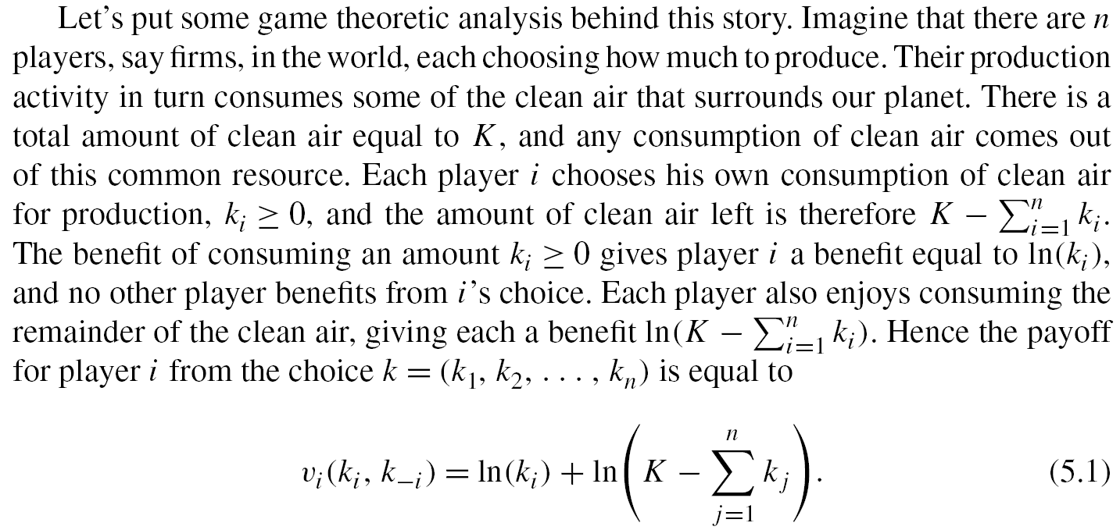
博弈论与信息经济学
北京航空航天大学经济管理学院 崔志伟

Slide 33
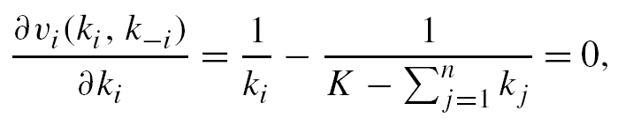
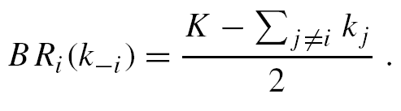
To solve for a Nash equilibrium we can compute the best-response correspondences for each player and find a strategy profile for which all the best-response functions are satisfied together.
To get player i’s best-response function, we write down the first-order condition of his payoff function:
and this gives us player i’s best response function,
We then have n such equations, one for each player, and if we substitute the choice k_{i} instead of BR_{i} (k_{-i} ) we get the n equations with n unknowns that need to be solved.
博弈论与信息经济学
北京航空航天大学经济管理学院 崔志伟

Slide 34
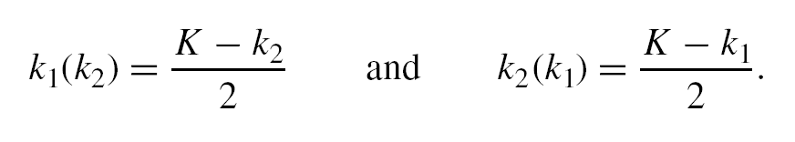
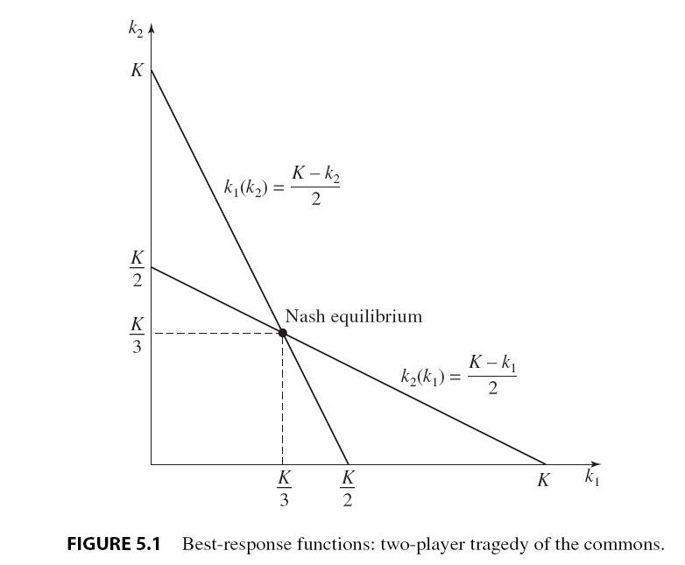
We proceed to solve the equilibrium for two players. Letting k_{i} (k_{j} ) be the best response of player i, we have two best-response equations:
博弈论与信息经济学
北京航空航天大学经济管理学院 崔志伟

Slide 35

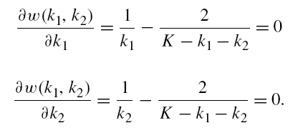
Now we can ask whether this two-player society could do better. The right way to answer these questions is using the Pareto criterion: can we find another consumption profile that will make everyone better off?
To find such a profile we’ll use a little trick: we will maximize the sum of all the payoff functions, which we can think of as the “world’s payoff function.”
The first-order conditions for this problem are
博弈论与信息经济学
北京航空航天大学经济管理学院 崔志伟

Slide 36
Solving these two equations simultaneously will result in Pareto-optimal choices for k₁ and k₂.
The unique solution to these two equations yields k₁=k₂ = K/4, which means that from a social point of view the Nash equilibrium has the two players each consuming too much clean air.
博弈论与信息经济学
北京航空航天大学经济管理学院 崔志伟

Slide 37
5.2.5 Political Ideology and Electoral Competition
Given a population of citizens who vote for political candidates, how should candidates position themselves along the political spectrum?
One view of the world is that a politician cares only about representing his true beliefs, and that drives the campaign.
Another more cynical view is that politicians care only about getting elected and hence will choose a platform that maximizes their chances.
The second view is precisely the view taken in the seminal model introduced by Hotelling (1929).
博弈论与信息经济学
北京航空航天大学经济管理学院 崔志伟

Slide 38
Imagine that there are two politicians, each caring only about being elected.
There are 101 citizens, each labeled by an integer −50, −49, . . . , 0, . . . , +49, +50. Each citizen has political preferences: let’s call the “−50” citizen the most “left”-leaning citizen and the “+50” citizen the most “right”-leaning citizen.
Each candidate i chooses his platform as a policy a_{i} ∈ {−50, −49, . . . , 0, . . . ,+49, +50}. Each citizen chooses the candidate whose platform is closest to his political preferences.
博弈论与信息经济学
北京航空航天大学经济管理学院 崔志伟

Slide 39

博弈论与信息经济学
北京航空航天大学经济管理学院 崔志伟

Slide 40
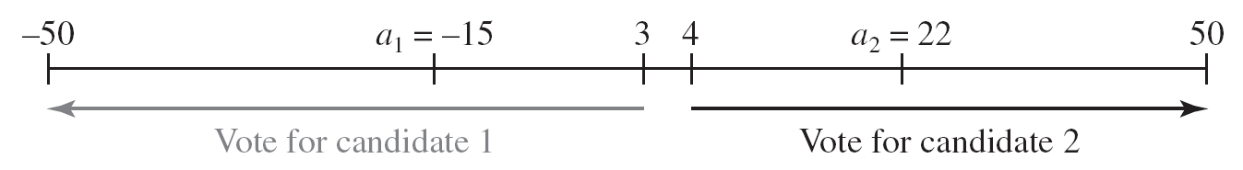
For example, if candidate 1 chooses platform a₁ =−15 while candidate 2 chooses platform a₂ =+22, then
all the citizens at or above +22 will surely vote for candidate 2,
(2) all the citizens at or below −15 will surely vote for candidate 1, and
(3) those in between will split between the candidates.
In particular those citizens at or below 3 will vote for candidate 1, while those at or above 4 will vote for candidate 2.
博弈论与信息经济学
北京航空航天大学经济管理学院 崔志伟

Slide 41
The outcome is determined by majority rule: if a majority of citizens vote for candidate i then he wins.
Since there is an odd number of voters, unless someone is indifferent, one candidate will always win.
In the event that a citizen is indifferent between the candidates then the citizen tosses a coin to determine for whom to vote.
Assume that the candidates want to win, so that they prefer winning to a tie, and they prefer a tie to losing.
博弈论与信息经济学
北京航空航天大学经济管理学院 崔志伟

Slide 42
Now consider the best response of player i.
If player j chooses a policy a_{j} > 0 then by choosing a_{i} = a_{j} or a_{i} = -a_{j} there will be a tie.
By choosing a_{i} >a_{j} or a_{i} <-a_{j} , player i will surely lose.
While by choosing a_{i} ∈ [-a_{j} + 1, a_{j} − 1], player i will win, so any platform in this interval is a best response to a_{j} > 0.
Similarly a symmetric argument implies that any platform in the interval a_{i} ∈ [ a_{j} + 1, -a_{j} − 1], is a best response to a_{j} < 0.
Observe that the best response to a_{j} = 0 is zero.
博弈论与信息经济学
北京航空航天大学经济管理学院 崔志伟

Slide 43
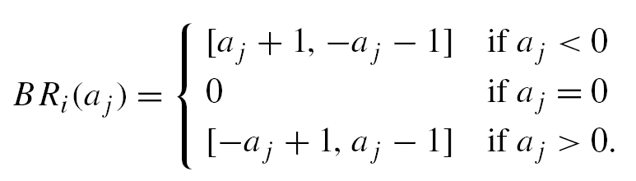
Thus we can write the best-response correspondence of each player as
It is easy to see that there is a unique Nash equilibrium, a₁ = a₂ =0, implying that both candidates position their platforms smack in the middle of the political spectrum!
Indeed, as Hotelling (1929, p. 54) wrote, “The competition for votes between the Republican and Democratic parties does not lead to a clear drawing of issues, and adoption of two strongly contrasted positions between which the voter may choose. Instead, each party strives to make its platform as much like the other’s as possible.”
博弈论与信息经济学
北京航空航天大学经济管理学院 崔志伟

Slide 44
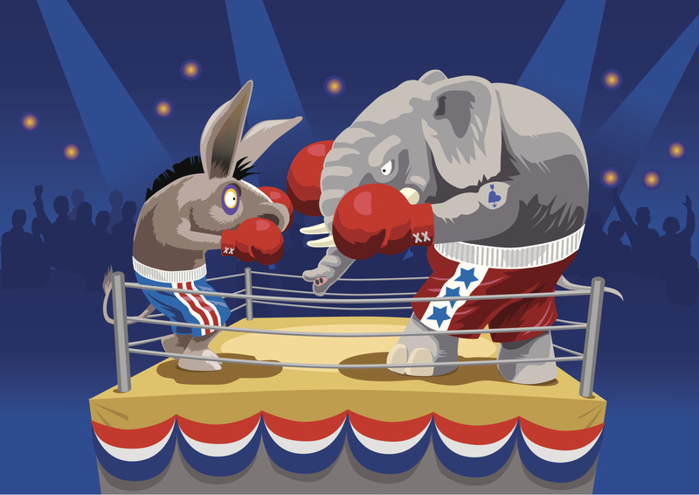
民主党的象征是一头驴，而共和党是一头大象。
博弈论与信息经济学
北京航空航天大学经济管理学院 崔志伟

Slide 45


博弈论与信息经济学
北京航空航天大学经济管理学院 崔志伟

Slide 46
Matching pennies is the name for a simple game used in game theory. It is played between two players, Even and Odd. Each player has a penny and must secretly turn the penny to heads or tails. The players then reveal their choices simultaneously. If the pennies match (both heads or both tails), then Even keeps both pennies, so wins one from Odd (+1 for Even, −1 for Odd). If the pennies do not match (one heads and one tails) Odd keeps both pennies, so receives one from Even (−1 for Even, +1 for Odd).
H
T
H
1, -1 | -1, 1
-1, 1 | 1, -1
T
博弈论与信息经济学
北京航空航天大学经济管理学院 崔志伟

Slide 47
Consider the following Rock-Paper-Scissors game:
Player 2
R
P
S
R
0, 0 | -1, 1 | 1, -1
1, -1 | 0, 0 | -1, 1
-1, 1 | 1, -1 | 0, 0
Player 1
P
S
For the interested reader, Section 6.4 discusses some conditions that guarantee the existence of a Nash equilibrium, which was a central part of Nash’s Ph.D. dissertation. This fact gives the Nash solution concept its power—like IESDS and rationalizability, the solution concept of Nash is widely applicable.
博弈论与信息经济学
北京航空航天大学经济管理学院 崔志伟

Slide 48
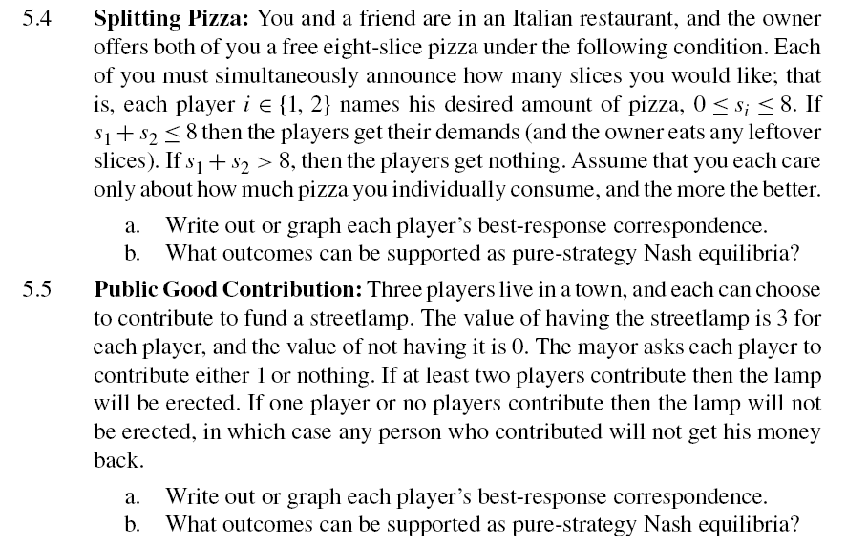
博弈论与信息经济学
北京航空航天大学经济管理学院 崔志伟

Slide 49
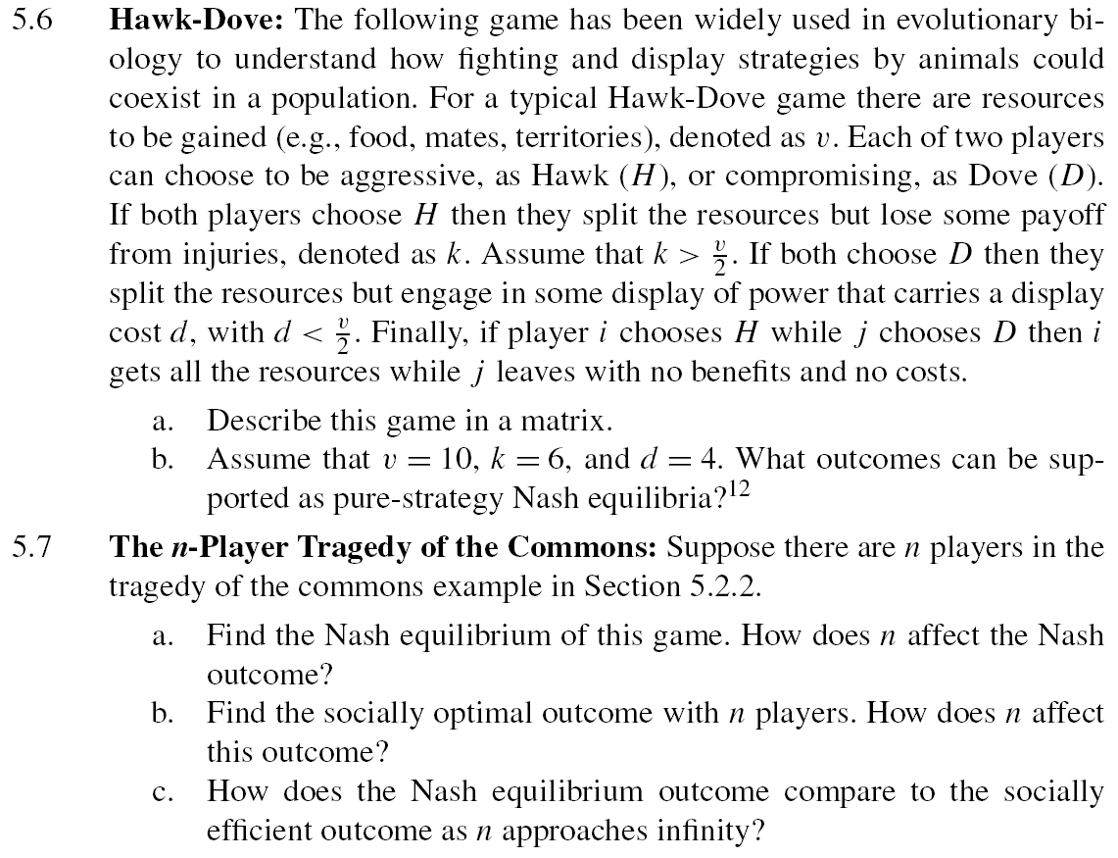
博弈论与信息经济学
北京航空航天大学经济管理学院 崔志伟

Slide 50
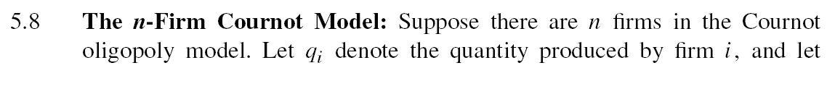
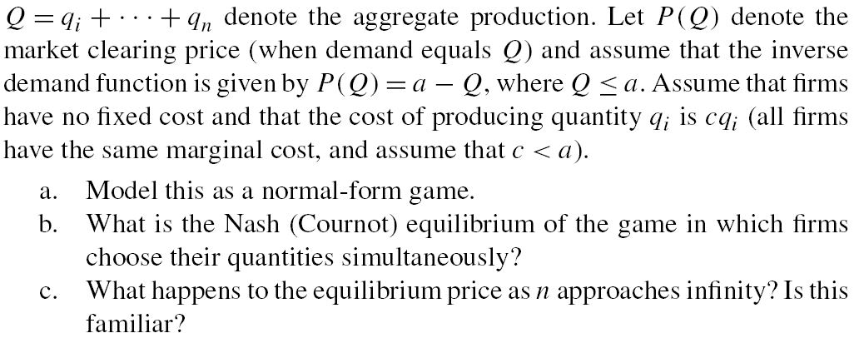
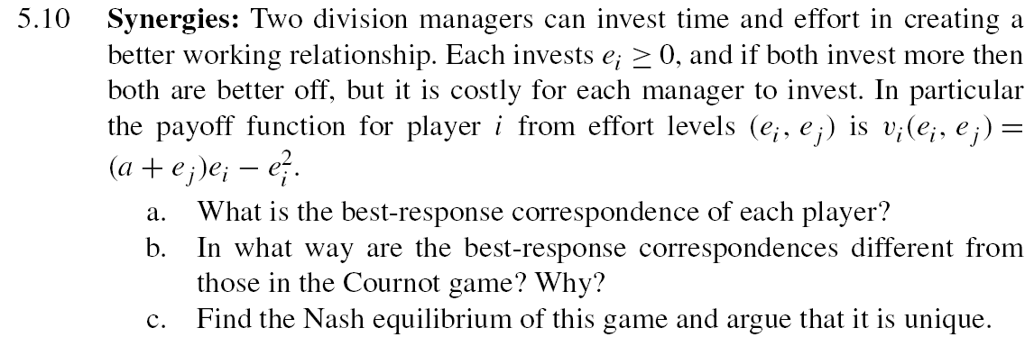
博弈论与信息经济学
北京航空航天大学经济管理学院 崔志伟

Slide 51
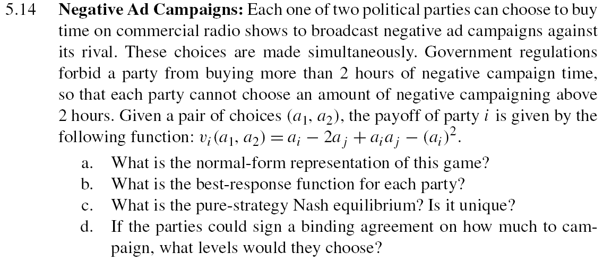
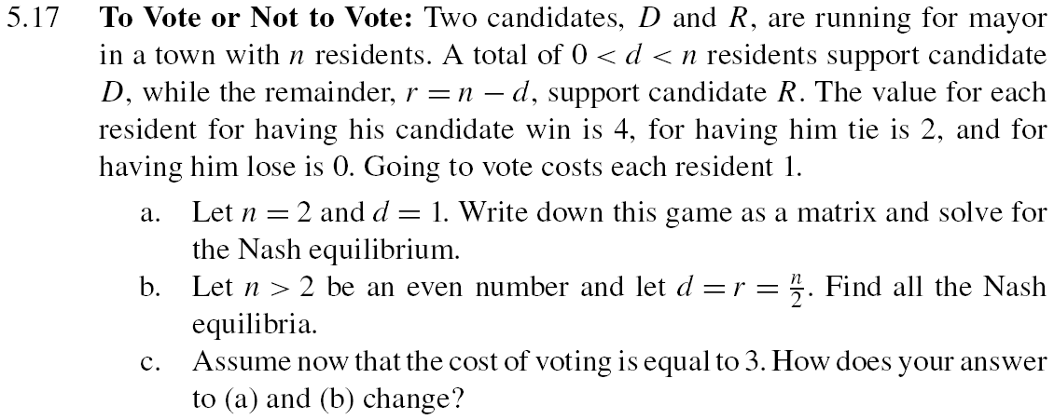
博弈论与信息经济学
北京航空航天大学经济管理学院 崔志伟

Slide 52


博弈论与信息经济学
北京航空航天大学经济管理学院 崔志伟

Slide 53
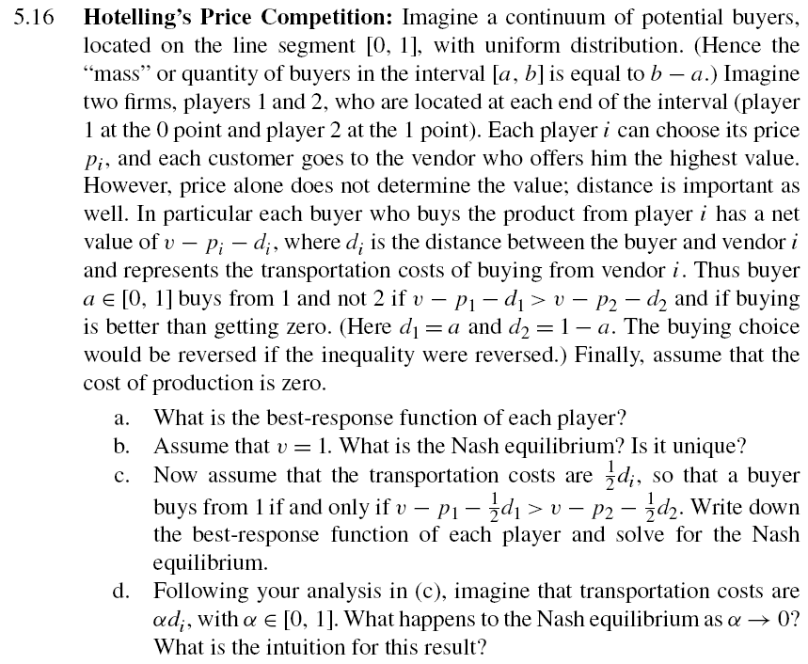
博弈论与信息经济学
北京航空航天大学经济管理学院 崔志伟

